Slide 1




Developing Graduate Attributes Through The Sustainability Agenda And Problem-based Learning
Workshop Friday 30th November 2012
Keele Hub for Sustainability
Keele University

Slide 2
1. PROBLEM-BASED LEARNING IN A CHANGING HIGHER EDUCATION ENVIRONMENT
Zoe Robinson
Keele University
Notes:
Range of people in the audience – very different stages in their careers – so apologies to those for whom this is very much part of their day to day life, but hopefully useful to some if not all
Although our project centred around sustainability education, aware that works with other agendas that we’re all having to contend with.
Today’s workshop centred around graduate attributes – been a key driver in curriculum reforms in many institutions.

Slide 3
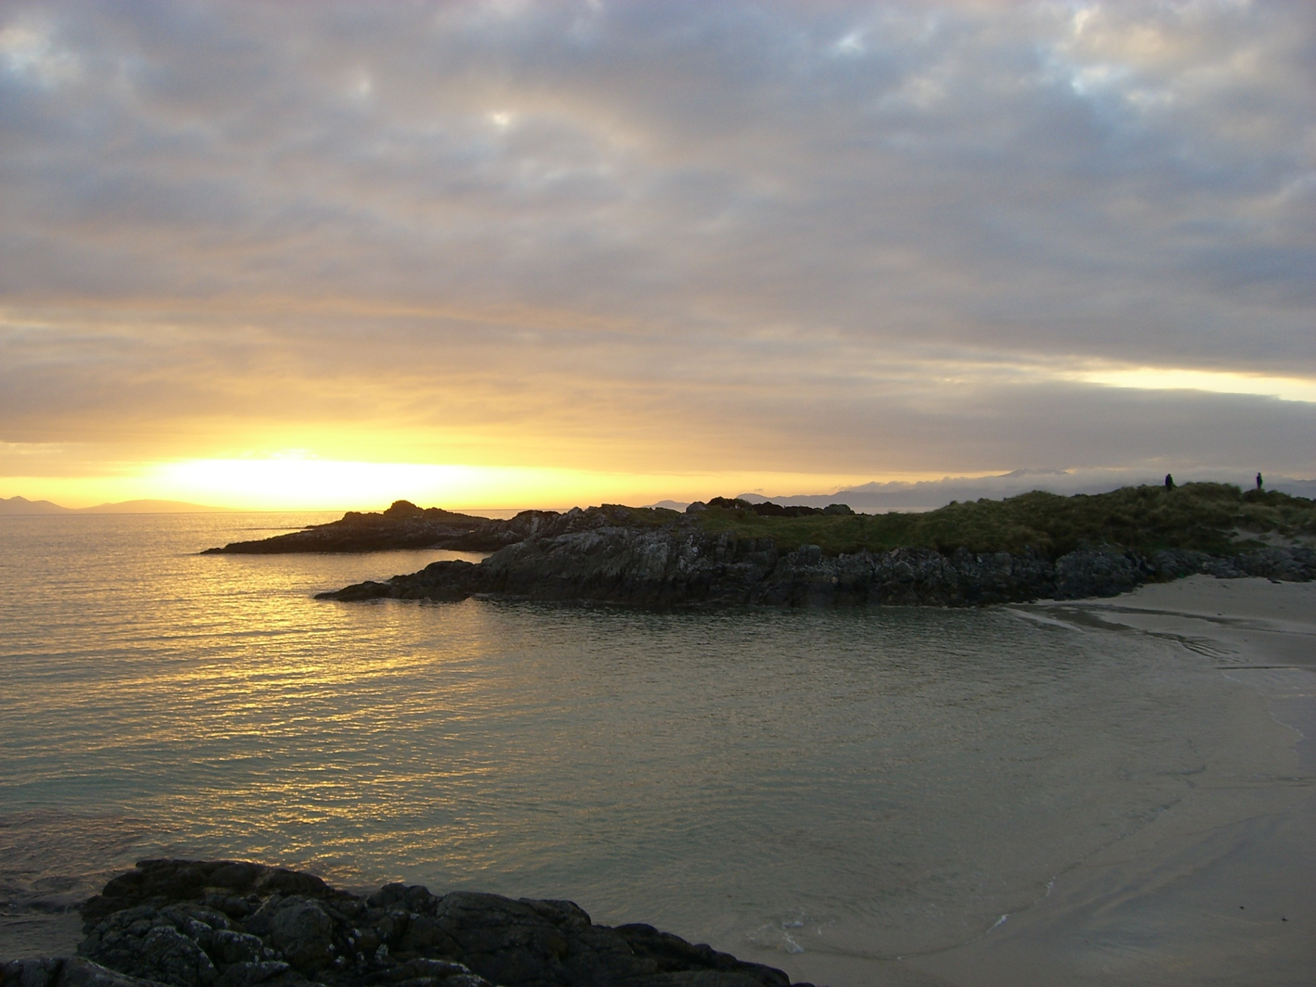
Education for Sustainability
“It is worth noting that (the destruction of the planet) is not the work of ignorant people. Rather it is largely the results of work by people with BAs, BScs, LLBs, MBAs, and PhDs …Education can equip people to be more effective vandals of the earth. If one listens carefully, it may even be possible to hear the Creation groan every year in late May when another batch of smart, degree-holding, but ecologically illiterate, Homo sapiens who are eager to succeed are launched into the biosphere”. – David Orr, 1994

Slide 4
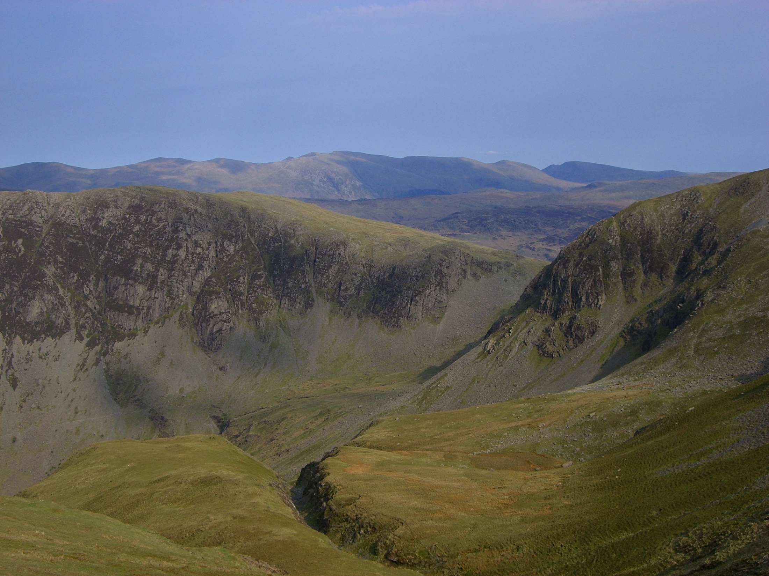
What is meant by ‘Sustainable Development’?
The Classic ‘Brundtland’ definition. Sustainable Development is development that:
  ‘meets the needs of the present without compromising the ability of future generations to meet their own needs’ (WCED, 1987)
‘Sustainability represents a condition whereby human and natural systems can continue indefinitely in a state of mutual well-being, security and survival’ (Jones et al., 2010)
Notes:
Not the Tories version
Often critiqued
-is constant development sustainable?
Hence now use of Sustainability – without the implicit development
However, I’m happy to use them interchangeably
Where would get you to draw ‘sustainability’ and ‘non’-sustainability’
4

Slide 5
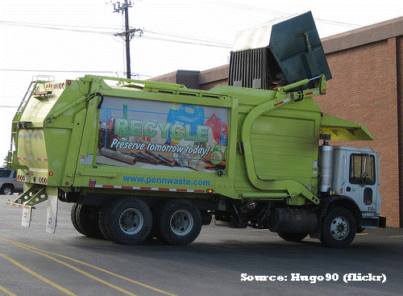
Sustainability is not just about recycling….
….or the environment
SUSTAINABLE
But what about education for sustainability (ESD or EfS)?
Economic
prosperity
Environmental
quality
Social justice
Notes:
It’s not just about recycling...
Economic – highlights something not sustainable about our current economic systems
5

Slide 6
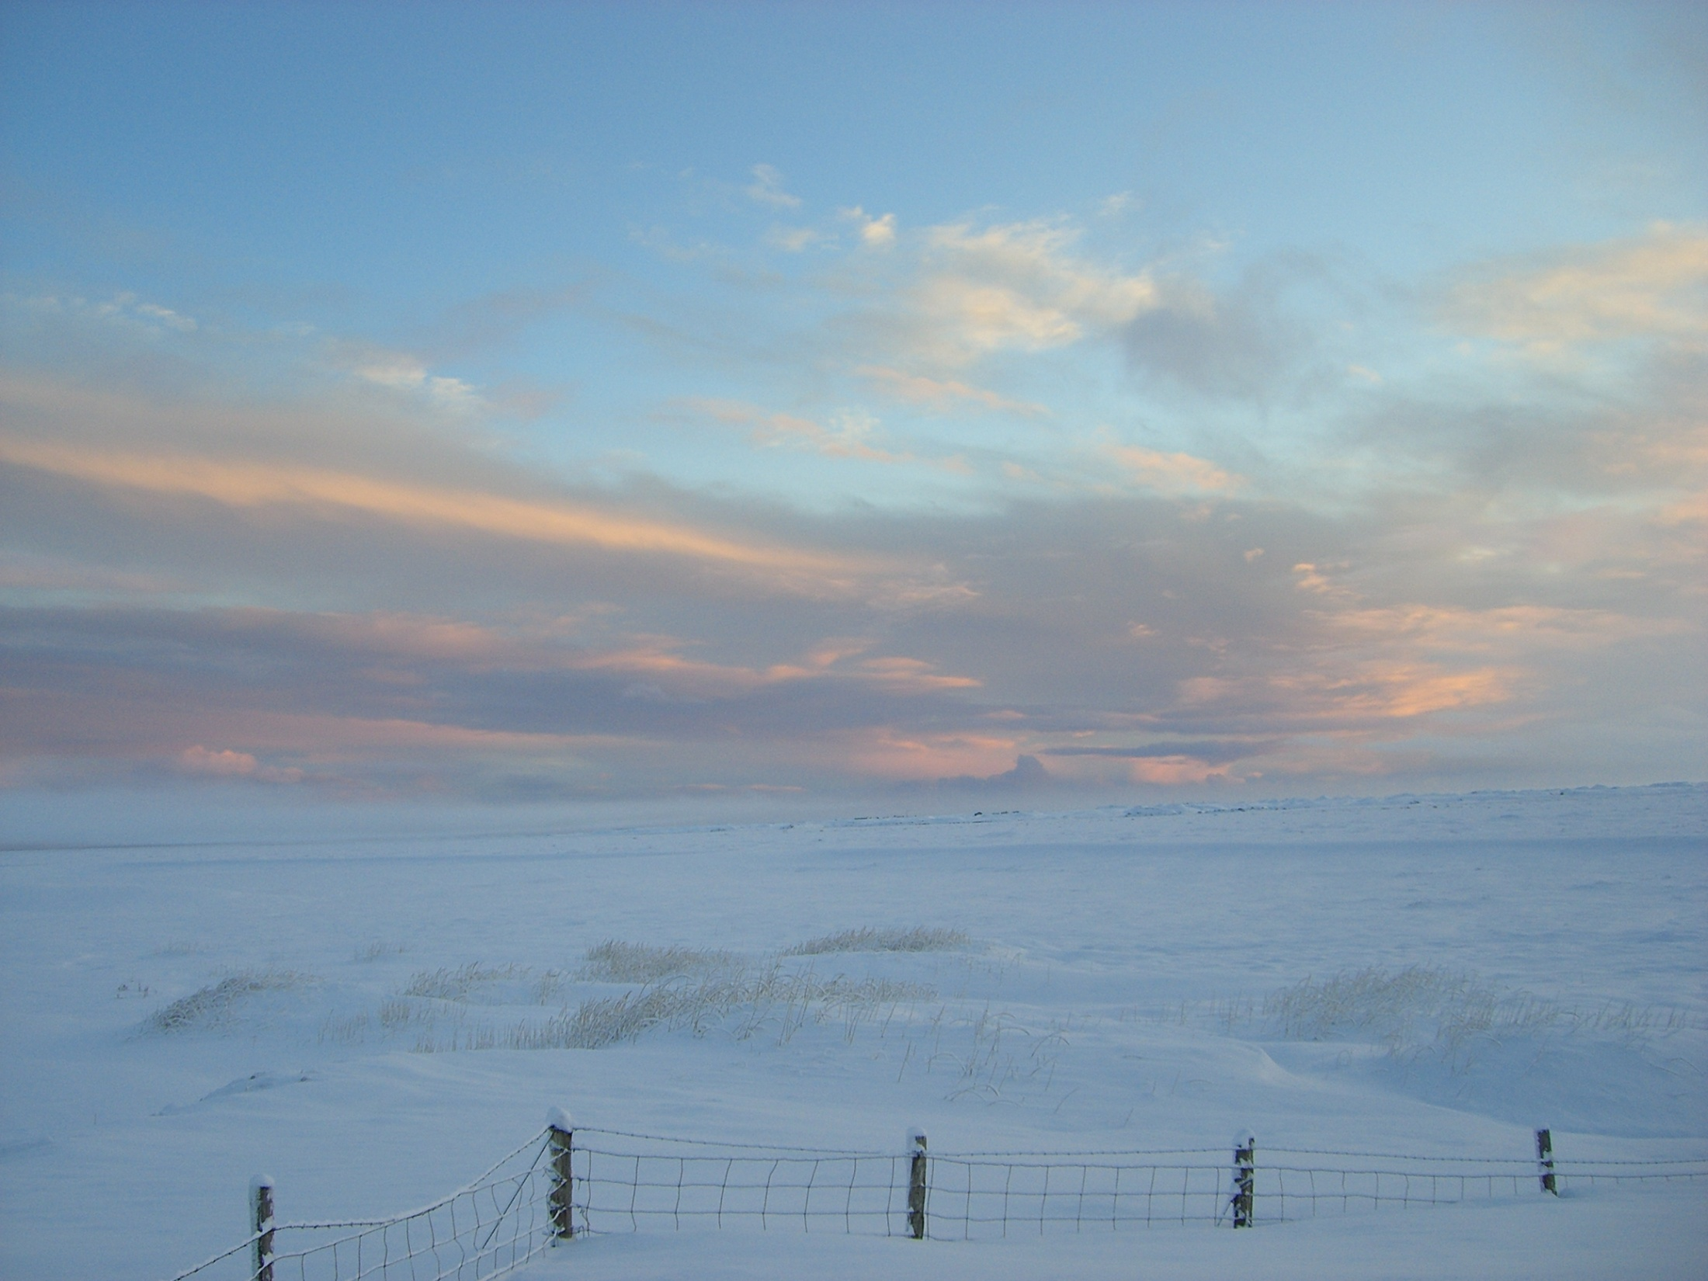
ESD/EfS is transformative learning
ESD/EfS challenges existing practices and looks for more sustainable alternatives
ESD/EfS generates shifts in the perspectives and frames of reference of learners, as well as their beliefs, attitudes and reactions
The potential to create ‘change agents’
“If you make every university graduate 10 per cent more sustainable, however you measure it, that’s more impact than if you switch off all the lights in every university for a year” Iain Patton, Chief Executive, EAUC

Slide 7
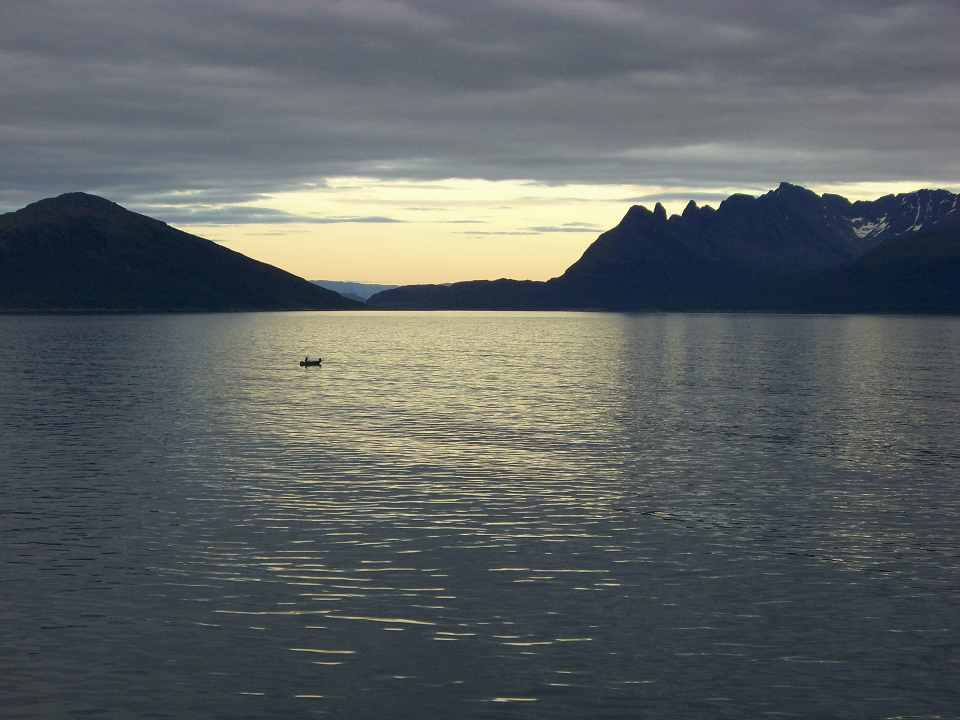
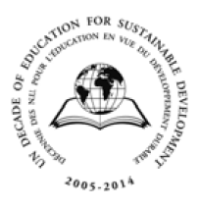
International drivers for ESD
1992: UN Conference on Environment and Development, Rio. Education seen as ‘critical for promoting sustainable development and improving the capacity of people to address environmental and development issues.’
2005-2014 UN Decade for Education for Sustainable Development
Promotion of the following values:
  Respect for the dignity and human rights of all people throughout the world and a commitment to social and economic justice for all
  Respect for the human rights of future generations and a commitment to intergenerational responsibility
  Respect and care for the greater community of life in all its diversity, which involves the protection and restoration of the Earth’s ecosystems
  Respect of cultural diversity and a commitment to build locally and globally a culture of tolerance, non-violence and peace
Notes:
Influential in linking the challenge of sustainability to education and learning. ESD also known as Education for Sustainability (EfS)
Various definitions of SD source of considerable academic debate.
UNESO framework nurtures critical perspectives anbd supports decentred, locally meaningful and subject-specific development – strong global and international dimensions
Educational innovation for SD seen as essential since 1992 Earth Summit in Rio, importance of education restated at J’burg World Summit in 2002
Acceleration in support since 2005 – UNESCO
Formal and informal eductaion
Helping to make the world a better place
7

Slide 8
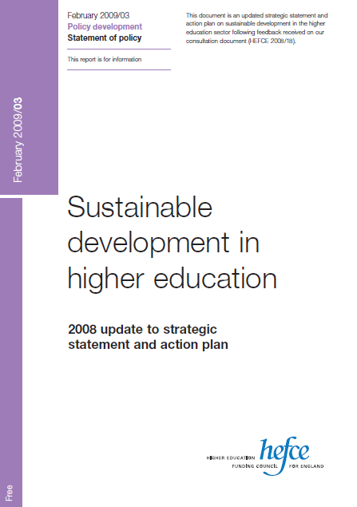
National drivers…
“Within the next 10 years, the higher education sector in this country will be recognised as a major contributor to society's efforts to achieve sustainability - through the skills and knowledge that its graduates learn and put into practice, its research and exchange of knowledge through business, community and public policy engagement, and through its own strategies and operations.” (HEFCE 2009/03)
“…The greatest contribution education has to make to sustainable development is by enabling students to develop new skills and knowledge. The main (though not only) way to make this happen is through developments in curricula and pedagogy.” (HEFCE, 2005)
Notes:
2005 HEFCE published a policy document entitled ‘SD in HE’ – outlining a vision where SD becomes a central part of HEFCE’s strategy for fuure development
Our HE systems have contributed to these unsustainable scenarios
8

Slide 9
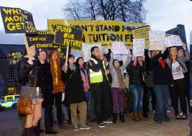
The student demand
Students see skills for SD as significant for employability and their future employers
A growing numbers of students are seeking both universities and employers who incorporate and reflect good sustainability practices
See: CSF (2009), Bone and Agombar (2011)
Notes:
They are the change agents
Graduates will be faced by very different conditions than those of a generation ago
Student demand is growing
Capabilities necessary to cope with conditions of uncertainty, complexity and rapid change
65% of respondents believe that sustainability skills should be delivered
throughout the curriculum rather than through a separate module;

Slide 10

The non-educational imperative
UK government’s vision for a new ‘green economy’
  Technological development, different ways of living and working
  New business opportunities and green jobs
  New demands from the workforce
Many reports supporting:
  employer demand for ‘sustainability-literate’ graduates
  Student demand for ‘future-proof’ skills
Highlights the need for HEIs to provide UGs with the opportunities to develop these skills
Notes:
New demands form workforce and a range of opportunities
Resilience to long term challenges
All businesses must grow with less environmental impact and greater resilience to future environmental challenges
Reports:
Leitch review
StudentForce for Sustainability
10

Slide 11
So what are Graduate Attributes?
“The qualities, skills and understandings a university community agrees its students should develop during their time with the institution. These attributes include but go beyond the disciplinary expertise or technical knowledge that has traditionally formed the core of most university courses. They are qualities that also prepare graduates as agents of social good in an unknown future.” Bowden et al., 2000, p1
Notes:
Aspirational statements
Many universities have begun to critically reexamine what is taught and learnt as part of a university education. The reform agenda has been prompted by a range of rapidly accelerating global and national, social, economic, technological and policy changes, which are impacting on the fundamental roleand function of a university
An aspirational list of knowledge, skills, and vbalues which they will be able to live out in the wider world of work and their lioves
Despite the necessary narrowness of formal tertiary programme of study, there is also breadth to the experience of the university itself.

Slide 12

What different theme are covered in your institutions Graduate Attributes?

Slide 13
Key areas….
Discipline Expertise
Professionalism
Global Citizenship/Perspectives
Communication and Teamwork
Self-awareness
Reflective, Critical and Lifelong Learning
Interdisciplinarity
Problem solving
Flexibility
Technological literacy….

Slide 14
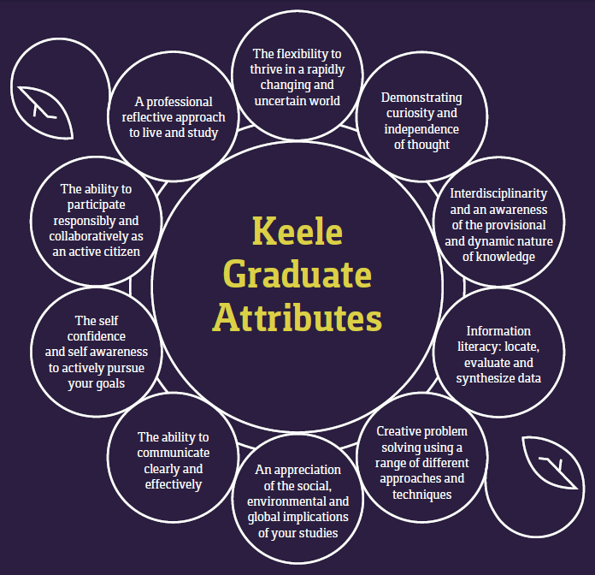

Slide 15
Manchester University
Critical thinking and higher order conceptual reasoning and analytical skills
Mastery of a discipline
Broad intellectual and cultural interest
Graduates prepared for professional and vocational work
Equipped to confront personal values and make ethical judgements
Prepared for citizenship and leadership in diverse, global environments
Advanced skills of written and verbal communication
Promotion of equality and diversity.
Staffordshire University
Discipline Expertise
Professionalism
Global Citizenship
Communication and Teamwork
Reflective and Critical Learner
Lifelong Learning

Slide 16
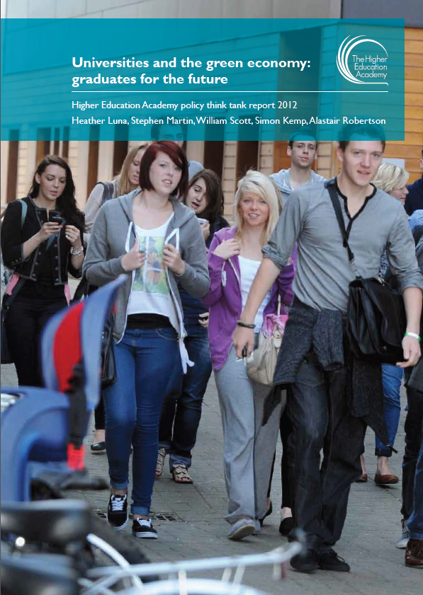
Universities and the green economy: graduates for the future
“The process of identifying graduate attributes opens up the possibility of whole-institution curriculum change in order to review, and perhaps renew, institutional vision and purpose, and thence to shape teaching and other student learning experiences in particular ways, and so offer students a guarantee of exposure to particular ideas and values, whether as part of their formal studies, or through complementary experience” (HEA, 2012)
“Universities should enable students to develop the skills to work with the problems and uncertainty around them…”
Notes:
HEA policy ‘think tank’ exploring the links between national policy on the green economy and the emerging academic consideration of graduate attributes for the 21str century
United Nations Environment Programme discusses skills for the green economy and a need for managers to “develop the new perspectives, awareness and capacities required for ensuring a smooth transition” (OECD, 2010)

Slide 17
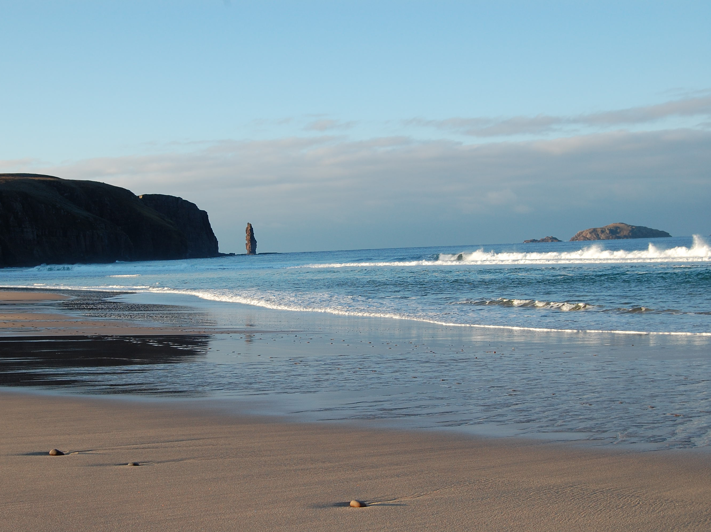
Other relevant agendas link with graduate attributes
Employability and professionalism
Internationalisation
Interdisciplinarity
Flexible and online learning
Lifelong learning
Enterprise and entrepreneurship
Notes:
17

Slide 18
2. Why Use Problem-based Learning For Sustainability Education?
Why do you think PBL is effective for sustainability education and/or delivery of graduate attributes?

Slide 19
Effective ESD requires pedagogical shifts from:
  Teacher-centred to student centred
  Individual learning to collaborative learning
  Theory dominated learning to praxis-orientated learning
  Sheer knowledge accumulation to problem solving
  Emphasis on cognitive objectives to skills-related objectives (after Wals and jickling, 2002)
“The nature of ESD demands new perspectives on matters like curriculum, teaching and learning. ESD and SD tend to focus on connections, feedback loops, relationships and interaction. Yet the dominant educational structures are based on fragmentation rather than connections and synergy” Wals, 2009, p64
Notes:
Many educators

Slide 20
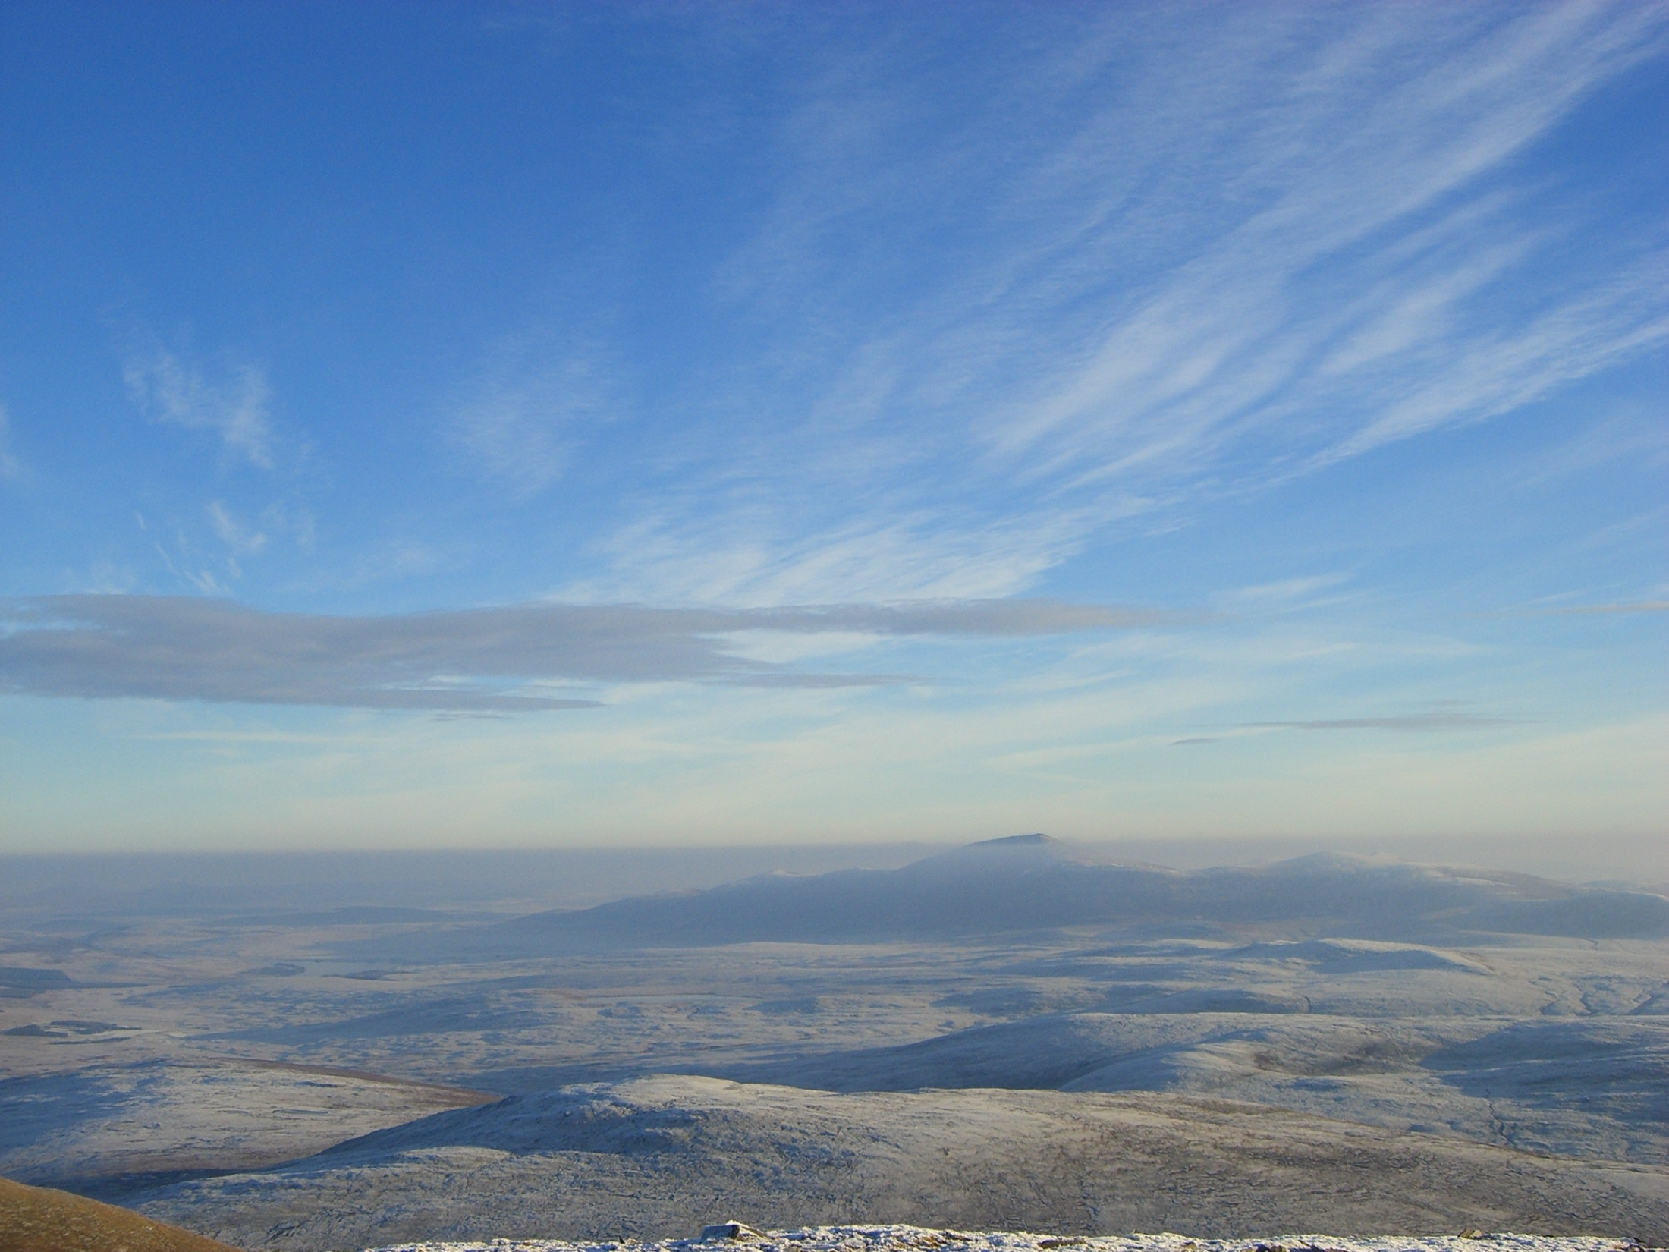
Why is ESD suited to PBL?
SD issues/problems are interdisciplinary and complex, often defined as ‘wicked problems’
ESD involves the development of skills and competencies not just theory
  Real world scenarios, and active, collaborative, experiential learning processes in PBL deliver this
Avoids delivering a single-dimensional/fragmented perspective of SD
Notes:
Through PBL students are encouraged to cross disciplinary boundaries, consider multiple viewpoints, and exchange ideas to build collaborative understanding

Slide 21
3. Introducing Traditional And ‘Hybrid’ Problem-based Learning

Slide 22
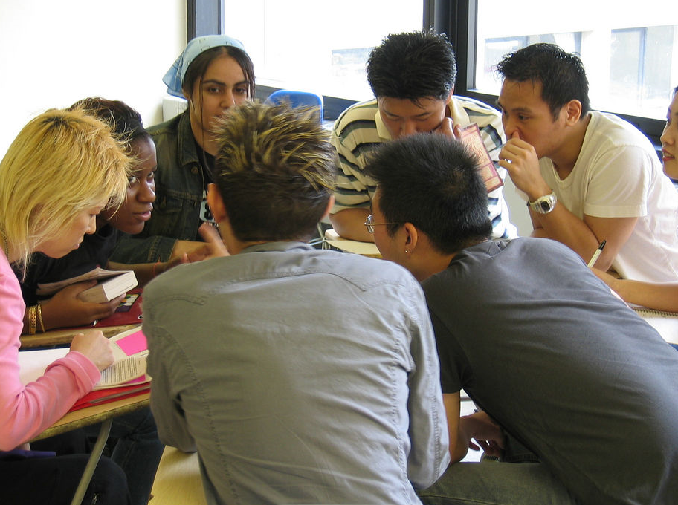
The ‘traditional’ PBL format
Tutors do not deliver content through lectures
Tutors become ‘facilitators’ of group learning
Tutors are learning enablers rather than knowledge givers
“This module is more practical and so more useful than other modules. Sitting in lectures you forget the information and only a few points stick in your mind. You remember more from this module. In this course we faced real problems, when you solve a problem you never forget how you solved the problem”

Slide 23
The ‘traditional’ PBL format (2)
Groups of ~8-10 students
Each group has a trained facilitator
Given problem/scenario/project brief – describing and outlining the problem
‘Wicked’ problems – open-ended, complex frameworks based around a specific topic
Regular meetings 1 or 2 a week with facilitator
May be assessed by exam
Notes:
23

Slide 24
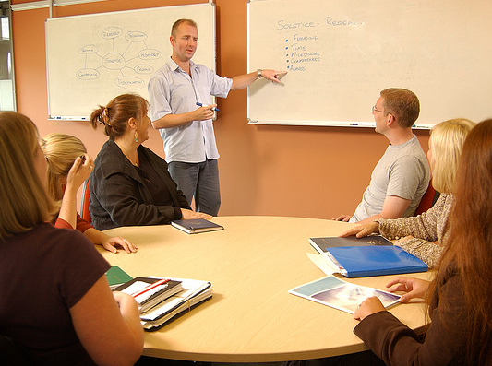
The ‘traditional’ PBL process
1) Highlight and clarify unfamiliar terms and concepts
2) Define the nature of the problems and issues fro exploration
3) Analyse and brainstorm the scenario by sharing group knowledge and experience
4) Formulate learning objectives for further research
5) Between group sessions self-directed learning based on the agreed learning objectives
6) Subsequent group sessions – sharing of private study
Student roles – chair, scribe
Facilitator adds information, ensures group process is effective
Notes:
24

Slide 25
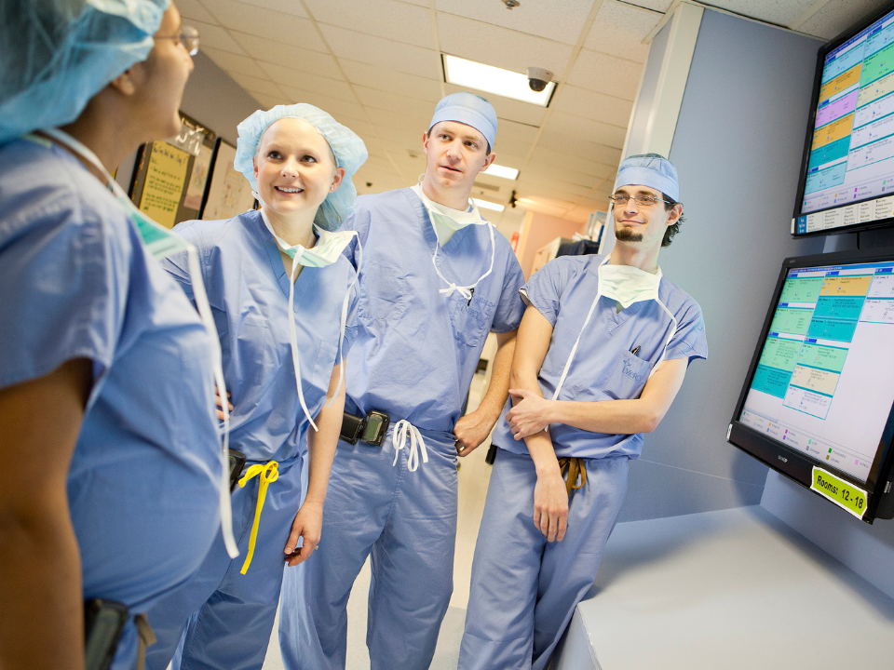
Example from medical education
Scenario based around a patient expressing the symptoms of appendicitis
  Narrative background information about the patient
  Narrative revealed bit-by-bit, discussion after each section
Agree learning objectives
Research – all students cover all learning objectives
  Background to disease
  Other possible explanations for the symptoms
  How to proceed with diagnosis and treatment
Discussion of research reinforces learning
Process analogous to real practice
Notes:
Content of module focused around problem scenarios
25

Slide 26
The role of the facilitator
Facilitate group process and PBL learning environment
Monitor attendance
Monitor and steer student discussions
Has background information and is familiar with the case study
Add guidance and data as need is identified but not definitive answers
Steers towards learning objectives if key areas are being missed
Staff (and room)
resource intensive
Notes:
26

Slide 27

So what is ‘Hybrid’ PBL?
Based on the principles of PBL but adapted from the traditional model
Adaptations made to overcome resource and time constraints of traditional PBL
Makes PBL more accessible and feasible for larger student cohorts in resource-constrained times
Notes:
27

Slide 28
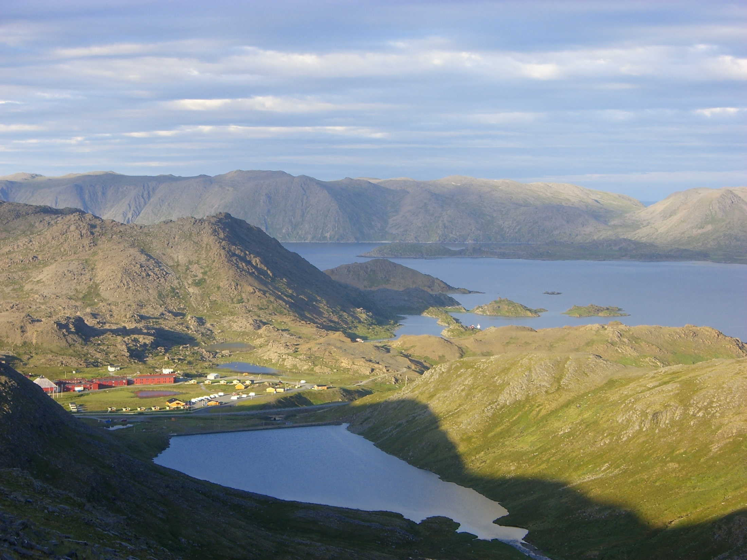
How does ‘Hybrid’ and traditional PBL compare?
Similarities
Student-driven group learning
Investigate open-ended (‘wicked’) problems
Students define learning objectives
Self-directed research
Some facilitation
Differences
Smaller groups
A mixture of classroom approaches
Less facilitator time
Online facilitation
Online learning materials
Online student communication
Online student collaboration
Innovative assessments
Notes:
Mixed classroom approaches – traditonal PBL, discussions and debates, min-lectures, outside speakers, videos….
Assessments – reflective journals, workbooks, videos, presentations
28

Slide 29
4. EXAMPLES OF ‘HYBRID PBL’

Slide 30
Greening Business-Keele University
The module:
  15 credits, 12 weeks
  Mixed-subject cohort
  Groups of 4
Different pbl briefs around improving University’s sustainability performance
Research
  Relevant sustainability issues
  Best practice
  Current institutional practice
  Justified recommendations
How?
  ‘Content’ delivered by podcast
  I-class group discussion
  Trial PBL scenario
  7 week assessed pbl project
Assessment:
  Group 5 min video summarising findings and recommendations
  Presented in front of University managers
  Individual reflected diary
Notes:
30

Slide 31
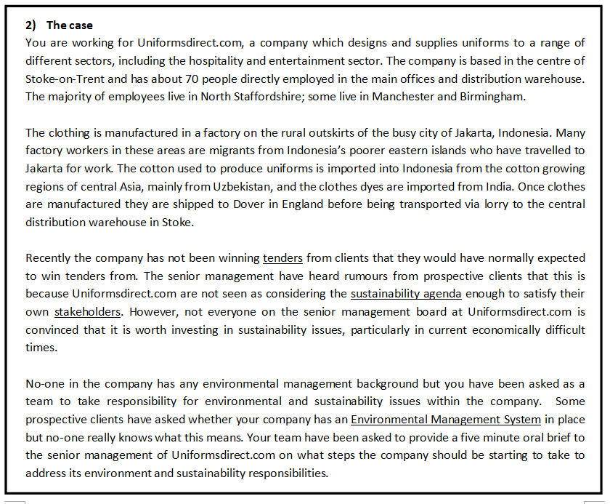
Example Scenarios

Slide 32
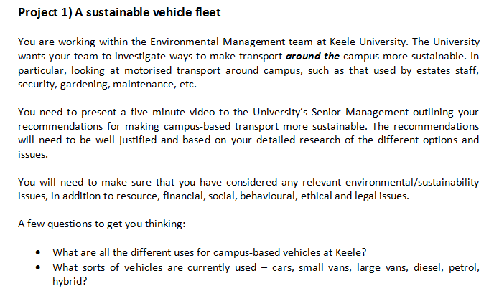

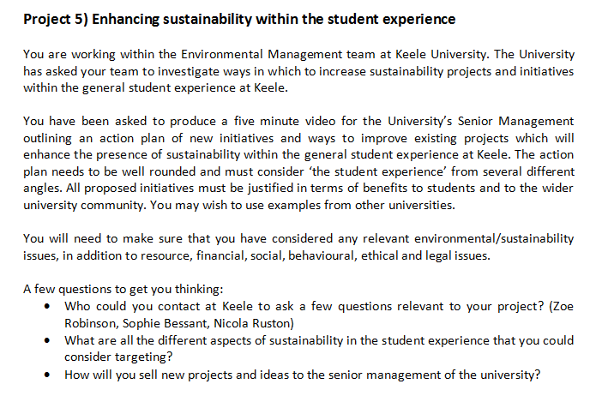

Slide 33


Greening the Campus –
Staffordshire University
The module:
  15 credits, 13 weeks
  Co-taught Level 4 / 5
  Mixed-subject cohort
  4 teams
Authentic, pbl brief:
Informing and changing the sustainability behaviours of first year students
  Themes: biodiversity, waste, energy, food
How?
  Early tutor led context sessions
  Mid-module student group investigation sessions
  End-module findings conference
Assessment:
  3 min awareness raising video clip
  Student newspaper article
  Follow-up intervention action plan
  Individual reflected diary
  Peer assessment
Notes:
3 tutor-led sessions giving global sustainability context
Brief negotiated with University’s environment and sustainability manager to:
‘inform and change the sustainability behaviour of 1st year students’
Groups work on different themes:
Biodiversity, energy, waste, food
Groups then:
Researched the broad sustainability context
Identified best practice in the University sector
Investigate current progress and practice
Assessed by:
Group video, news article, action plan, mini-conference
Individual reflective diary
Facilitation face-to-face and via VLE, email
33

Slide 34
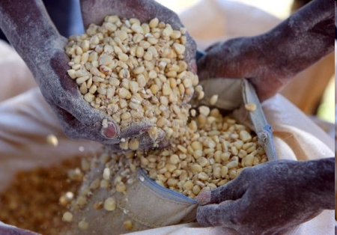
Project Managing Humanitarian Aid - Manchester University
The module:
M-level
Short group projects
Interdisciplinary and multicultural groups
How?
-Traditional PBL process
-One entirely online scenario
Assessment:
-Group report – modified by peer assessment of individual contributions
-Reflective report
PBL briefs:
Different Humanitarian aid scenarios
Covers concepts of stakeholder engagement, interaction of economic, environmental, legal, political, social and technical aspects of setting up humanitarian aid projects
Notes:
Having been set a tsk students share existing knowledge and experience, formulate a oplan, seek and analyse further information
, discuss possible approavhes
34

Slide 35
How do students benefit?
Enable students to be more effective in their future career:
  Working collaboratively with a diverse range of people
  Tackling projects where they have no prior knowledge
  Handling complexity and uncertainty
  Rigorous approach to researching, critically, analysing information sources

Slide 36
5. LINKING PBL TO OTHER HE AGENDAS AND GRADUATE ATTRIBUTES
Notes:
PBL the ideal vehicle for the integration of subject knowledge with skills and comptencies and the development of graduate attributes
Grad attributes

Slide 37

Employability and professionalism
Active learning and problem solving
Team working
Project management
Leadership
Developing a logical and analytical approach to unfamiliar situations

Slide 38

Employability and professionalism
Critical reasoning and reflection
Negotiating and persuading skills
Group communication
Real-world scenarios
Audience focussed
Approaching professionals
“When we met Phil about the energy issues it was a really professional meeting and the topics we discussed were nicely in depth, really technical. In some modules it’s still like school. It’;s nice to be in a work-based environment”
Notes:
38

Slide 39

Internationalisation
Internationalised student cohorts
International real-world scenarios
“I really enjoyed this group….Our different cultural backgrounds and views really helped”
Notes:
Experience of collaborating with others from different cultures.
Moduels have attacted a broad mix of students
Gain new perspectives, differing viewpoints
Scenarios drawn from around the globe - Bland
39

Slide 40

Interdisciplinarity
Work with students from different programmes
Sustainability inherently interdisciplinary
Peer-learning
“People on different courses all had different views on the issues, for example I took a more science-based approach to the answers, whereas people on the Environment and Sustainability course took a more legal and legislation approach. So [as] a whole my breadth of knowledge was greatly expanded”
“Our group contained a good mixture of people with different backgrounds, skills and knowledge. This created a good platform for discussion and allowed us to delegate tasks during the project that people were best able to do”
Notes:
Experience of collaborating with others from different cultures.
Moduels have attacted a broad mix of students
Gain new perspectives, differing viewpoints
Scenarios drawn from around the globe - Bland
40

Slide 41

Enterprise and entrepreneurship
Thinking creatively
Devise original solutions to problems
Notes:
Experience of collaborating with others from different cultures.
Moduels have attacted a broad mix of students
Gain new perspectives, differing viewpoints
Scenarios drawn from around the globe - Bland
41

Slide 42

Transformative education
Learning to consider life through a ‘sustainability lens’ – appreciating the environmental, social and economic implications of our decisions and life choices
“One of my biggest fears is that you go through the education system and you learn information but you never put it into the context of business. I wasn’t interested in sustainability at all before starting and suddenly, now I love it. It’s a case of I can see myself doing sustainability within a job and see myself going into a company and suddenly being able to put all my skills into practice and then implementing sustainability within that business”
“I didn’t believe as an individual I could make a difference but now I know that I can”
Notes:
Experience of collaborating with others from different cultures.
Moduels have attacted a broad mix of students
Gain new perspectives, differing viewpoints
Scenarios drawn from around the globe - Bland
42

Slide 43

Lifelong learning
Becoming active rather than passive learners
  Students define what they need to research
Learning HOW to learn
“I think I am better at solving problems and creating solutions. I have further developed my ability to research a topic by identifying what is releavnt and the ways in which to find information””
Notes:
Self-directed learning
Determing what learning priorities are most important
Students define what they need to research
43

Slide 44
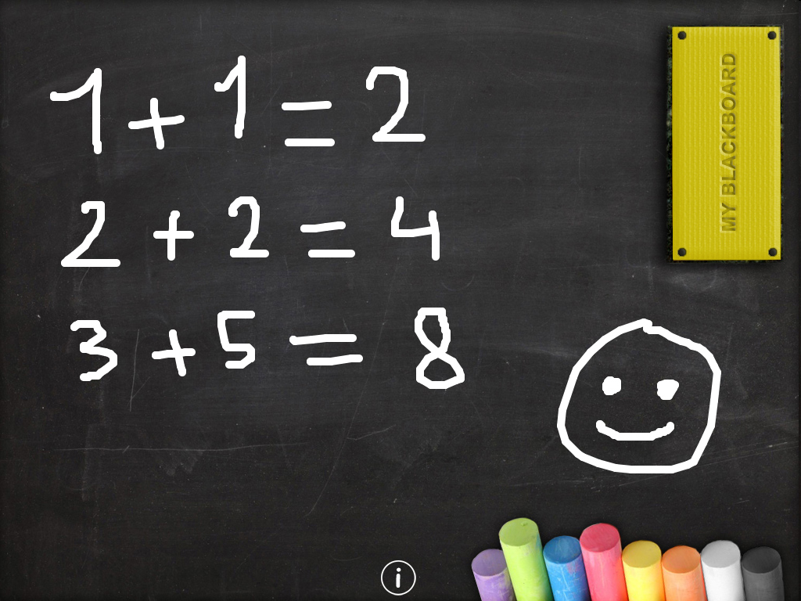
Additional benefits….
Research-informed teaching…
Researcher development…
Improved learning…
Students making friends…
Notes:
Flexibility of PBL curricuum – link researh to teaching. Use research projects as PBL scenarios
Facilitators develop skills
Making friends
44

Slide 45

Thank you!
Questions?
Notes:
45
45
Thanks you and keep up the good work!

